Slide 1


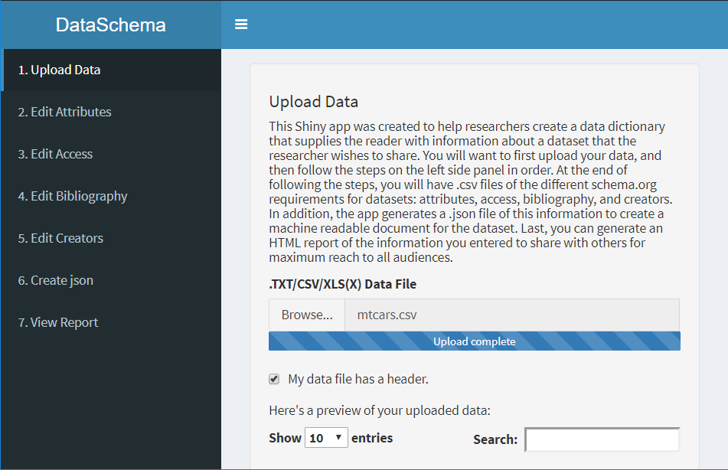
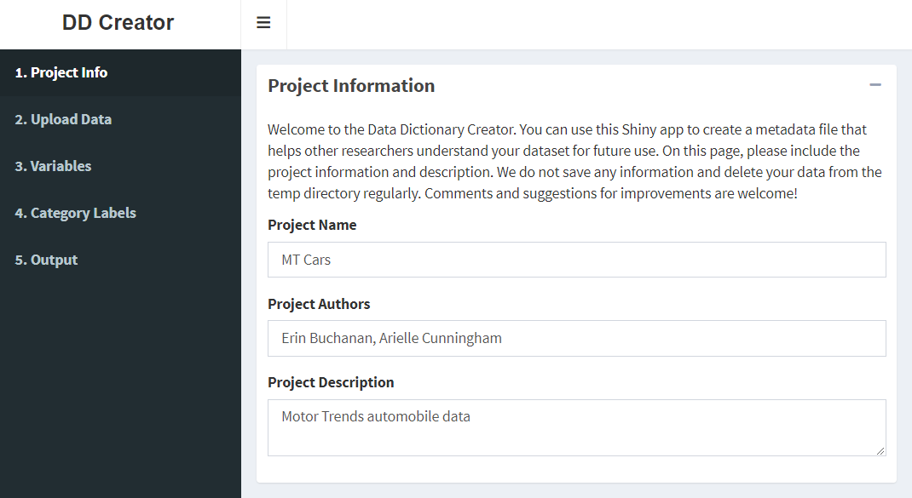
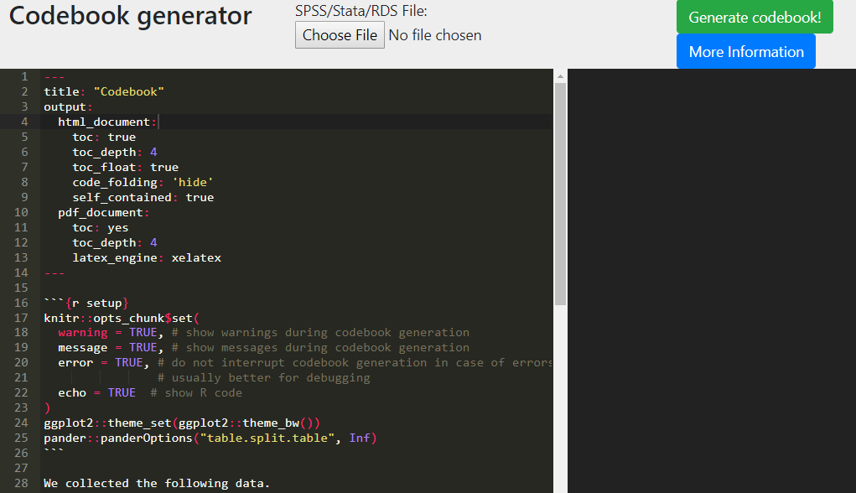
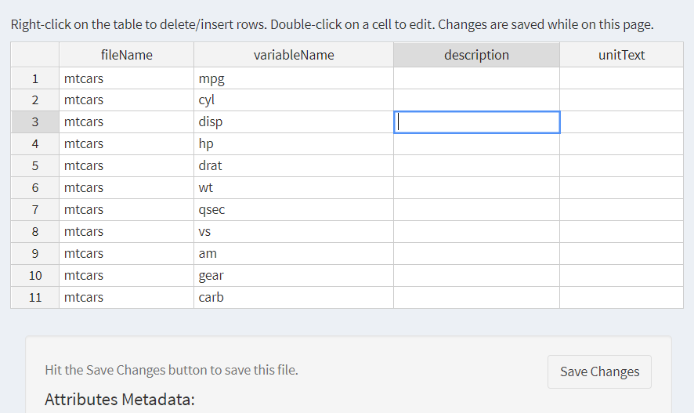
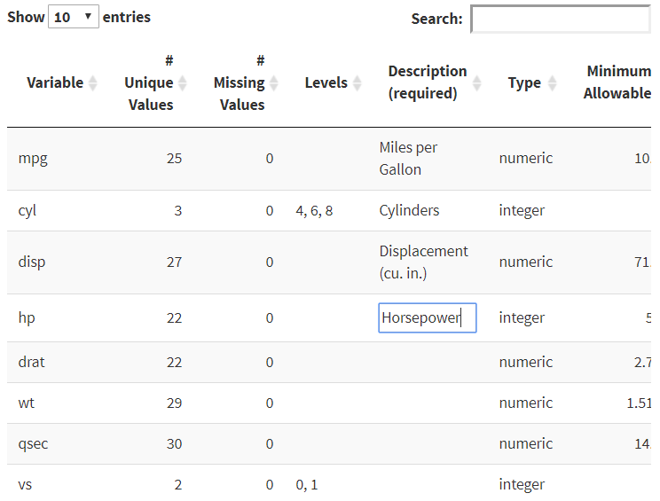
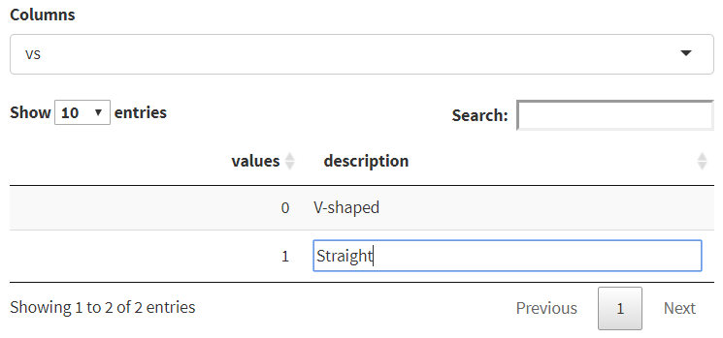
Getting Started Creating Data Dictionaries: Creating Shareable Datasets
Arielle Cunningham, Sarah E. Crain, Hannah R. Johnson, Hannah Stash, Erin M. Buchanan, PhD
Missouri State University
Progress in science depends on collaboration, but much of the scientific process happens out of sight in the lab, and often only the final publication is available. This process has led to problems such as p-hacking, analysis errors, and mass failure to replicate—all without the potential for detection and, ultimately, correction. One potential solution is to make the research process more public. Brian Nosek and Jeffrey Spies began the Open Science movement to aid other scientists by creating an online platform in which they could openly record, report, and share data (Nelson, Simmons, & Simonsohn, 2018)¹. Open data is beneficial for both individual researchers and science, because it facilitates the spread of knowledge and improvements in research. In fields where p-hacking and false positives run rampant, such as psychology, open data discourages fraud and makes replication more likely (Piwowar, 2013) ². Still, many researchers have concerns about opening their data. Concerns include copyright laws, time spent working to make data open, and, perhaps most importantly, participant confidentiality. We believe, nonetheless, that data can safely be made open in most cases. One way to make data more open is to use and share a data dictionary: a document that contains metadata describing a dataset. Metadata documents help researchers understand the dataset more efficiently and can allow for more closely matched replications. We looked into three potential data dictionary creators, each with its own benefits and limitations. Each researcher can choose which works best for his or her data and research goals. Codebook has the simplest procedure and provides useful information such as histograms, but allows only limited editing of information. DataSpice 2.0 works well in conjunction with Schema.org, which is a standardized set of practices for sharing computer readable information. Finally, DD Creator requires more data entry input but allows for more detailed descriptions, such as levels of a variable. It also outputs a data file with attributes embedded (Rdata). This project fits in with the broader perspective of the Psychological Data Structure project, which is creating specifications on open data practices. We highlight some of each app’s features below.
Summary
DataSchema
DD Creator
 | Codebook | DataSchema | DD Creator
Citation | Arslan (2018) ³ | Inspired by Data Spice (Boettiger et al., 2018) ⁴ | (DeBruine, Buchanan, & Mohr, 2018) ⁵
Input | CSV, SPSS, Stata, RDS | CSV, Text, Excel, SPSS, SAS | CSV, Text, Excel, SPSS, SAS
Output | HTML report from Markdown | CSV files of meta-data, JSON, and HTML report | CSV files of meta-data, JSON, Rdata
Benefits | Easiest to use Quick metadata generation Generates a summary for each variable in a readable format | Follows schema.org for output Metadata entry is medium | Follows schema.org Specifies a separate section for category labels Rdata output More detailed descriptions, depending on data
Codebook
DD Creator allows a user to enter metadata for each column provided in the dataset, while automatically providing a starting point for the number of unique values, missing values, variable type (i.e., character, numeric), and minimum/maximum values. A description of each column can be added, along with information about the levels/groups in the data and synonyms for the variables. On a separate page, category labels can be provided for both character and numeric data (i.e., Likert-type scales that include labeled numbers). The screenshots below display examples of these pages.
This application allows users to create an HTML report, a JSON file formatted following guidelines for datasets from schema.org, and .csv files of their metadata. JSON files are machine readable formats, which are encouraged for sharing. In this application, descriptions of the dataset properties (e.g., authors, collection dates) and column information should be entered to complete the metadata files.
Codebook is an R package with a corresponding website that allows researchers to create reports of their data, including reliabilities, summaries of items (histograms, descriptive statistics. Of the three available options, codebook is the quickest and easiest to implement; however, non computer savvy users would have trouble editing the automatically produced output if they wished to add more information.
References
Nelson, L. D., Simmons, J., & Simonsohn, U. (2018). Psychology’s Renaissance. Annual Review of Psychology, 69, 511–534. https://doi.org/10.1146/annurev-psych-122216-011836
Piwowar, H. A., & Vision, T. J. (2013). Data reuse and the open data citation advantage. PeerJ, 1, e175. https://doi.org/10.7717/peerj.175
Arslan, R. C. (2018). How to automatically generate rich codebooks from study metadata. https://doi.org/10.31234/osf.io/5qc6h
Boettiger, C., Chamberlain, S., Fournier, A., Hondula, K., Krystalli, A., Mecum, B., … Woo, K. (2018, October 10). dataspice. Retrieved November 24, 2018, from https://github.com/ropenscilabs/dataspice
DeBruine, L., Buchanan, E. M., & Mohr, A. H. (2018, July 1). ddcreator. Retrieved November 24, 2018, from https://github.com/debruine/ddcreator
For more information, please contact Arielle Cunningham at: arielle924@live.missouristate.edu
Check out the DataSchema code at: https://github.com/doomlab/shiny-server/tree/master/MOTE
Check out the DD Creator code at https://github.com/doomlab/data-dictionary/tree/master/ddcreator
Screenshot of the Attributes page, in which users can enter detailed information about the variables in their datasets.

